Slide 1
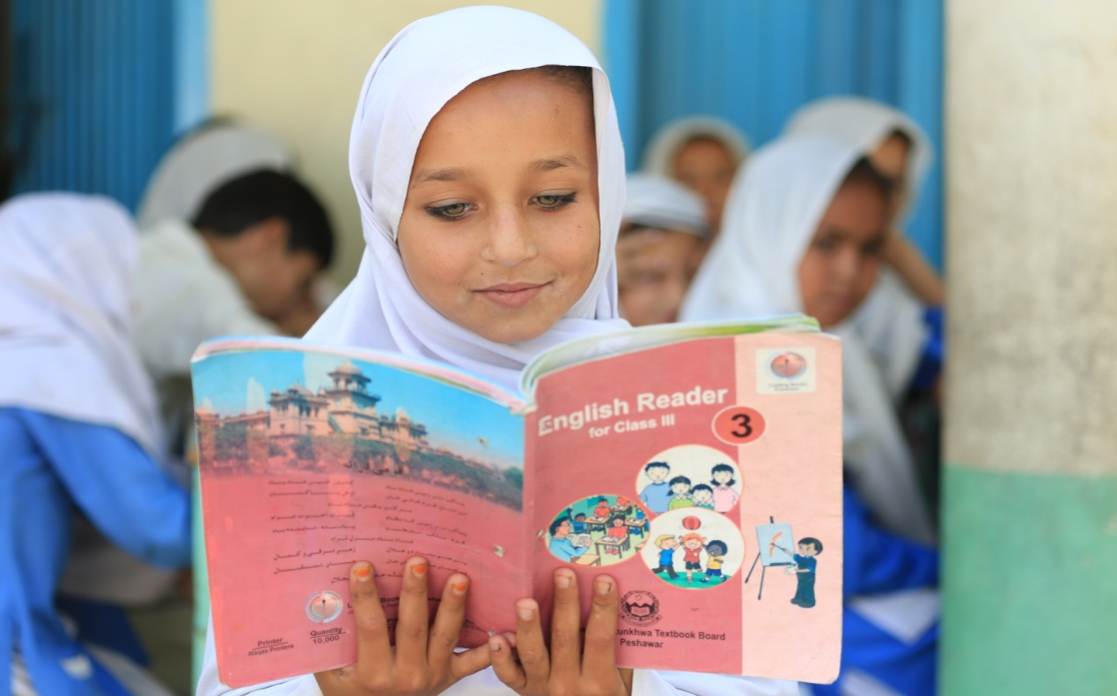
Non-profit , Non Partisan & Non-Governmental women led women Organization, Established in 1993 &
Registered under Society Act 1860 in Pakistan

Slide 2
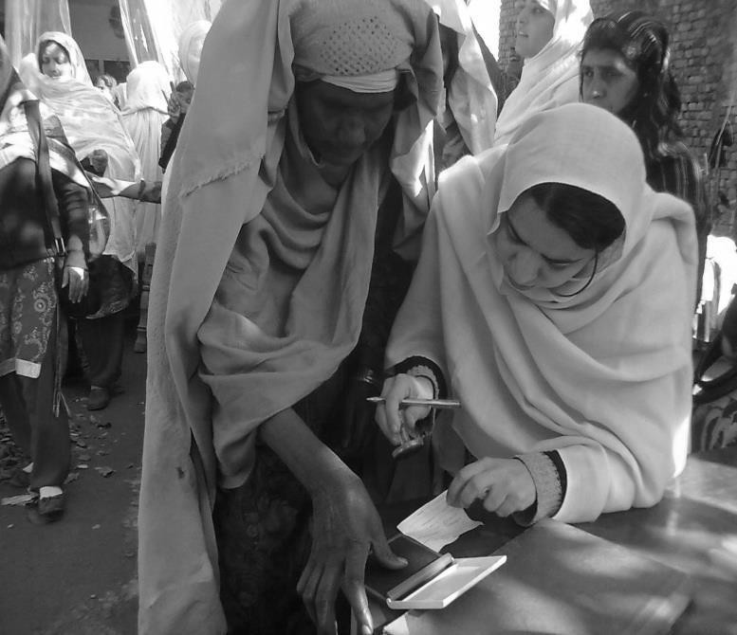
vision: A compassionate society where women and girls live with dignity and self-reliance.
Mission:
A learning and value based organization striving for resilient communities and empowered women.
Values:
Commitment
Accountability
Mutual Respect
Integrity

Slide 3
KK Legal Status
Societies Act 1860
Directorate of Social Welfare former FATA
Government of Pakistan Economic Affairs Division (EAD) through a memorandum of understanding (MOU).
Certified by Pakistan Centre for Philanthropy (PCP).
MoU signed with Police department, Education department
MoU with Election Commission of Pakistan

Slide 4
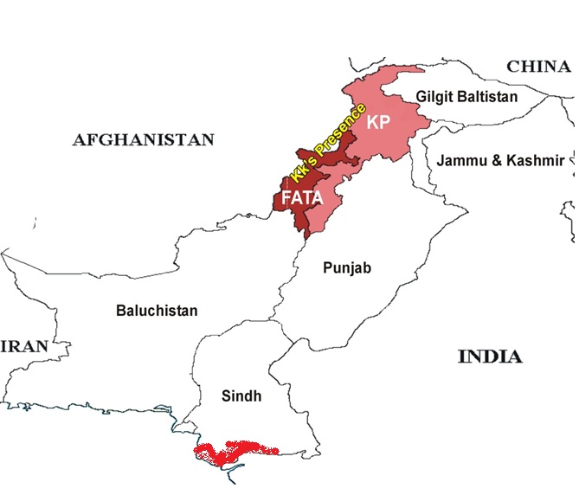
KK Geographic Coverage
KK working districts/agencies
14 districts + 7 Tribal areas and 6 FRs
KK working villages 203
Total Community Based Organizations 512
MOs 250
WOs 230
GBOs 32
Male members 5,429
Female members 4,697

Slide 5
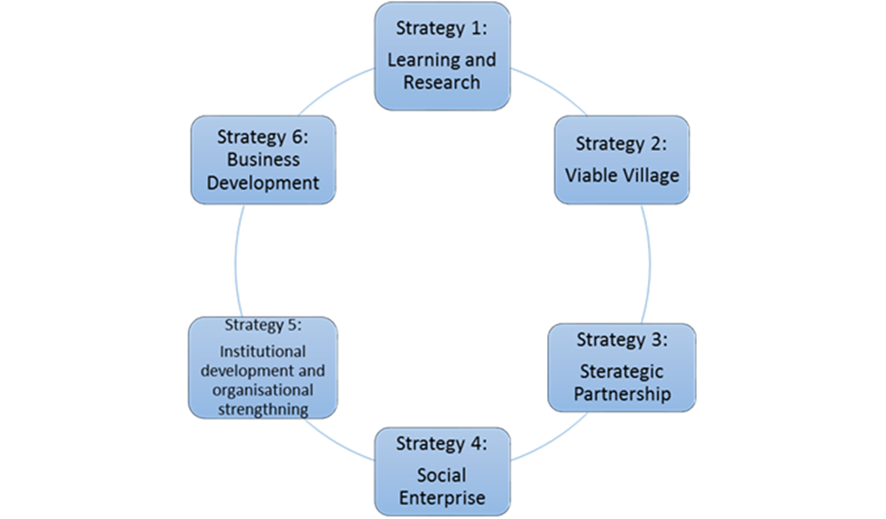
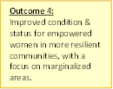
KK Strategic Framework (2017-26)
Notes:
Popn of Pakistan – 180m
Of KP = 22m
Of FATA = 3m
Patriarchal Society
Misinterpretation of Islam
Domestic violence,
Honor killing
Forced/early marriages
Law & Order Situation
Bomb Blasts
Humanitarians kidnapping
& targeting
Disasters
IDP’s (Flood, Conflict)
Earth quakes

Slide 6
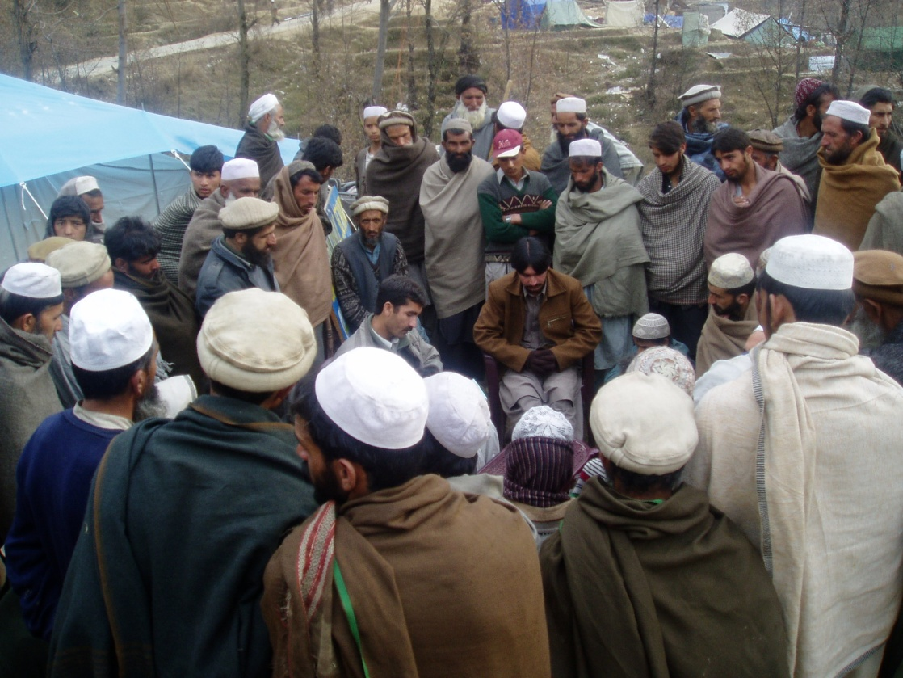
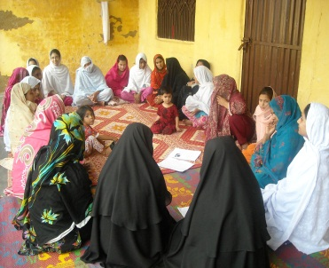
Community Mobilization
viable village APPROACH
Viable Village
Social Organization
Human Institutional Development
Linkages and Networking
Education
Civil Rights
Health
Economic Empowerment
PARTNERSHIP DEVELOPMENT WITH GOVERNMENT AND STAKE HOLDERS

Slide 7
KK outreach program wise Total beneficiaries: 118,783

Slide 8
Education
OBJECTIVE
To improve gender parity, quality of girls education & literacy for women.
COMPONENTS
Primary Education & Elementary Education
Adult Literacy
Total beneficiaries since 1993
40,760

Slide 9
Distinctions
Community Based Girls Education in the most deprived districts of KP and FATA.
Policy advocacy on legislation for Article 25-A, of the constitution of Pakistan (free and compulsory education)
I am the change award by Engro Foundation
KK schools were considered the best alternative learning model in KP and FATA out of 7 models selected by UNICEF
KK graduated students are now teachers at KK schools
KK is one of the non governmental organizations at province level to receive free text books for approx 4,000 children from government education department every year.
KK is one of the founding members of PCE (Pakistan Coalition for Education).
Innovation in classroom teaching initiated at Government primary schools.
Initiated 3 Schools under KK education system which are sustained

Slide 10
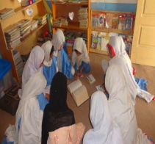
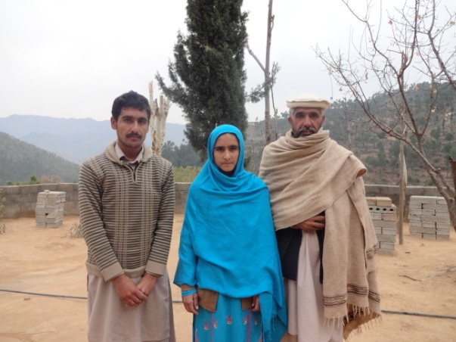
Ms. Neelam Bibi, our Ex- Student of Community Based School Buthqila, Asbanr has recently qualified the entry test and got admission in Fatima Jinnah Medical College and now she is doing her house job.
Girls at KK Community Based School Dir Lower , KP

Slide 11
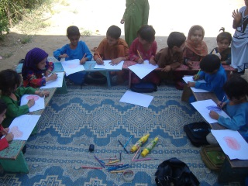
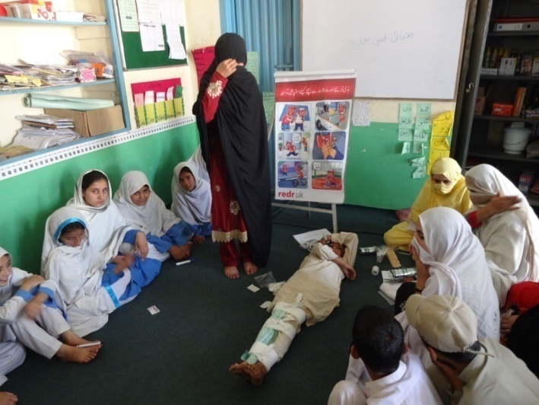
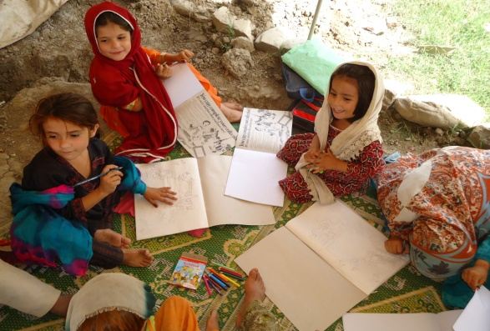

Slide 12
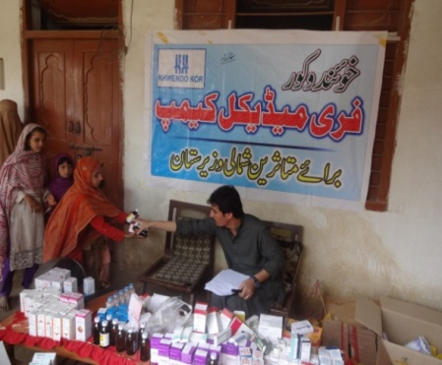
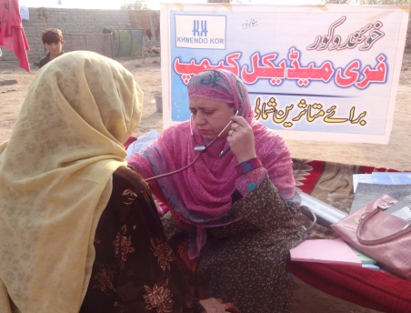
Health
OBJECTIVE
To improve the health status of women and children
COMPONENTS:
Maternal and Neo-natal health
Health & Nutrition Education
Community based Mental Health Care and Support
HIV & AIDs (SRHR for women and adolescent girls)
Free medical camp in FR Bannu

Slide 13
Outreach through health program Total beneficiaries since 1993 43,603

Slide 14
Distinction
Establishment and running of community health centre/health facilitation points, CHBCs, VCT labs
Provision of free medicine, TBAs Kits and other health services and facilities.
Capacity Enhancement (TBAs’ Trainings)
Outreach home based care and support for Sexual and Reproductive Health, Maternal and New born Health and HIV Aids)
Provision of Psychosocial support
Community based rehabilitation and Mental Health services.
Arrange & conduct free medical camps in deprived/un-served settled and humanitarian crises ridden areas.
Training and capacity enhancement of community men and women as Community Resource Persons (CRPs)
Rehabilitation, infrastructure and staff support to government health facilities.

Slide 15
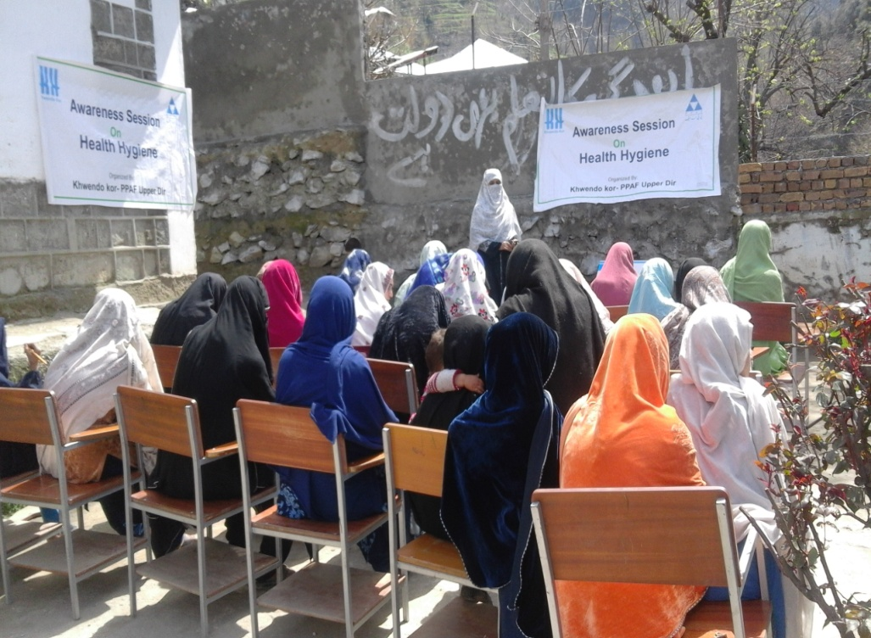
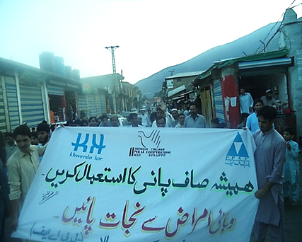
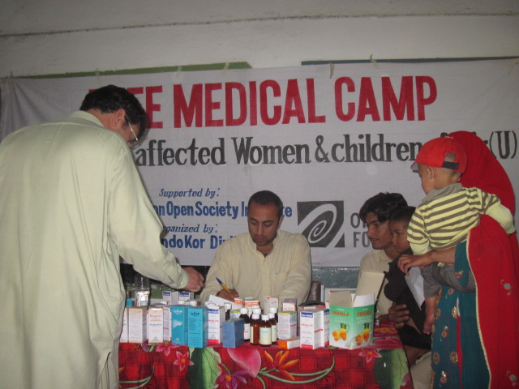
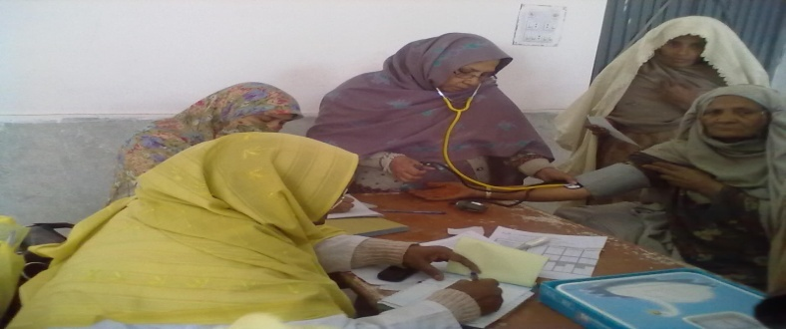

Slide 16
Economic Empowerment
OBJECTIVE
Economic and social status of marginalized women of KP and FATA has improved and sustained.
COMPONENTS :
Micro-Finance services
Natural Resource Management and vocational skills
Craft production and promotion

Slide 17
Distinctions
Establishment & running of micro finance branches for credit disbursement, recovery and saving mobilization to promote self employment among women.
The concept of Village banking for self help groups to avail opportunities at cheaper rate such as loan and utilization of personal group savings.
Establishment of trade facilitation centres to cater the business linkages and local display outlets of women home based workers.
Kits are distributed to potential trainees as business start-up for income generation.
Formation and strengthening of Effective Artisans Group at provincial level in KP to initiate advocacy for artisans supportive policies.

Slide 18
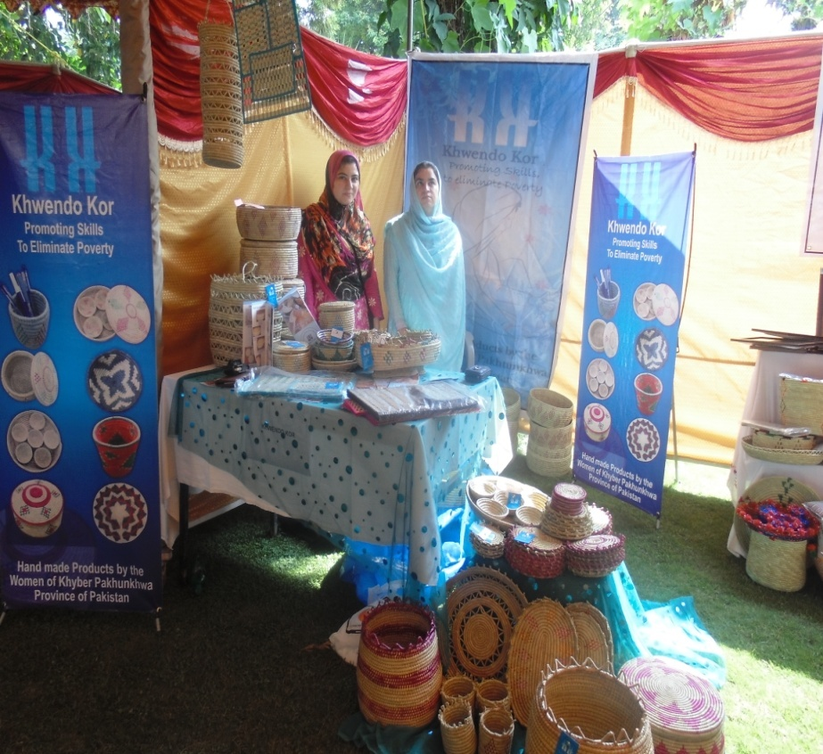
KK Participating in Exhibition organized by HRDN

Slide 19
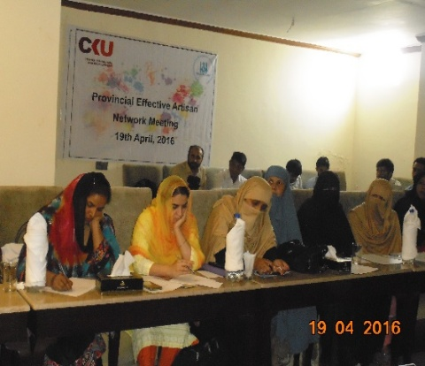
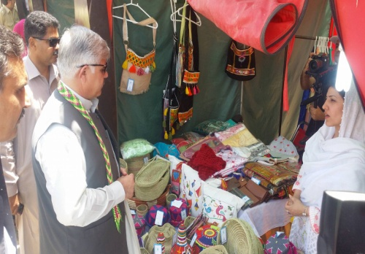
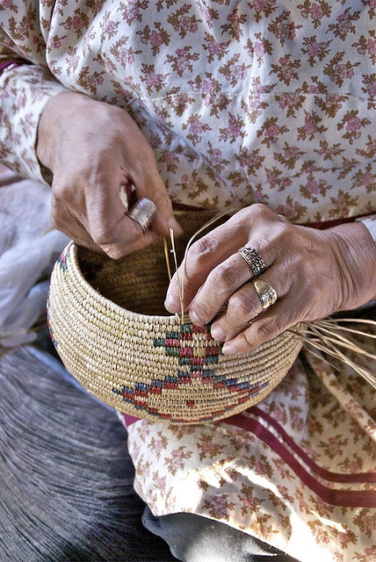
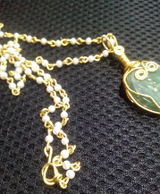

Slide 20
Civil Rights
OBJECTIVE
Women are aware, able and engaged in demanding their civil rights.
COMPONENTS:
Political Rights
inheritance Rights
Rights in family laws
Total beneficiaries since 1993
16,213

Slide 21
Achievements
13,175 women from KP and FATA have been facilitated to acquire CNICs (computerized National Identity Cards)
859 survivors of Gender Based Violence facilitated through Psycho social counselling, legal support and referral to relevant departments
Facilitating women leaders to context in general and local body elections
Facilitating women leaders to conduct social audits.
Making the dormant government facilities to become functional, active and responsive, KK has established three Women Complaint Cells at government police stations Mansehra.

Slide 22
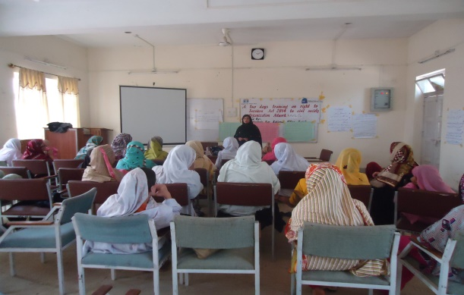
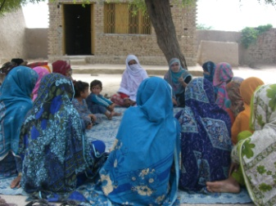
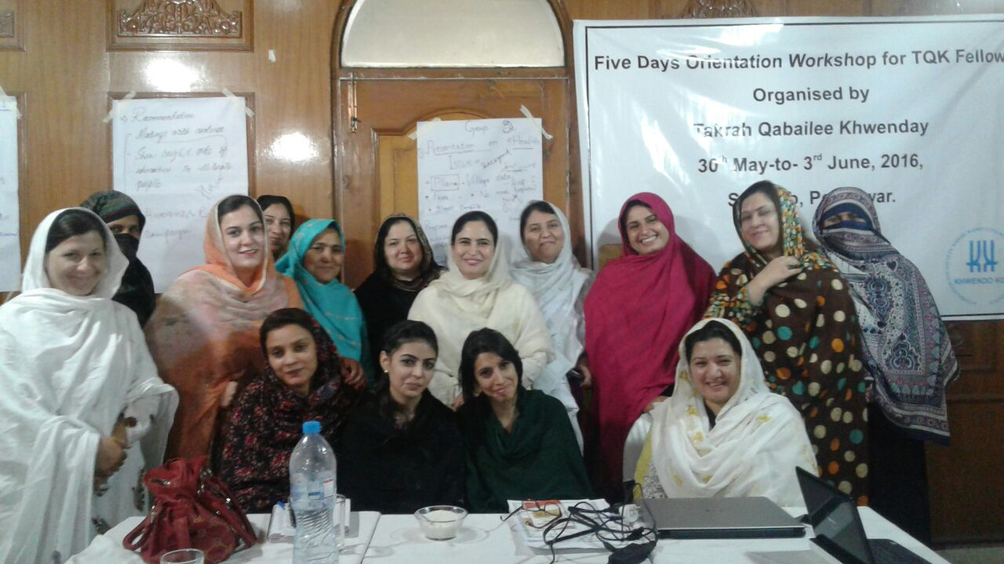

Slide 23
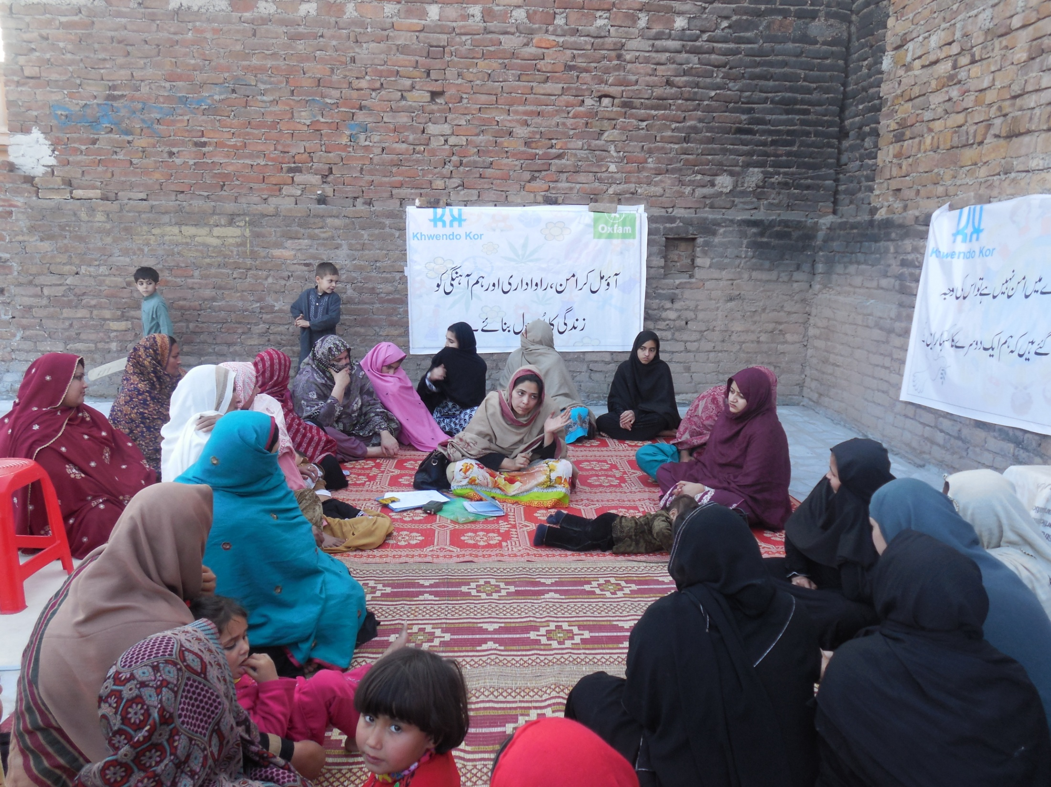

Slide 24
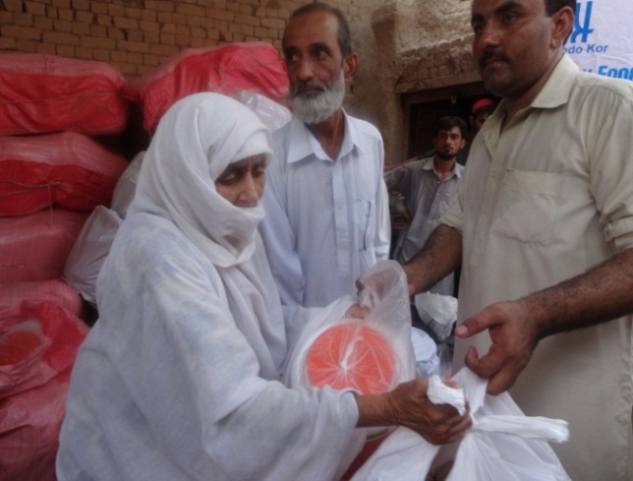
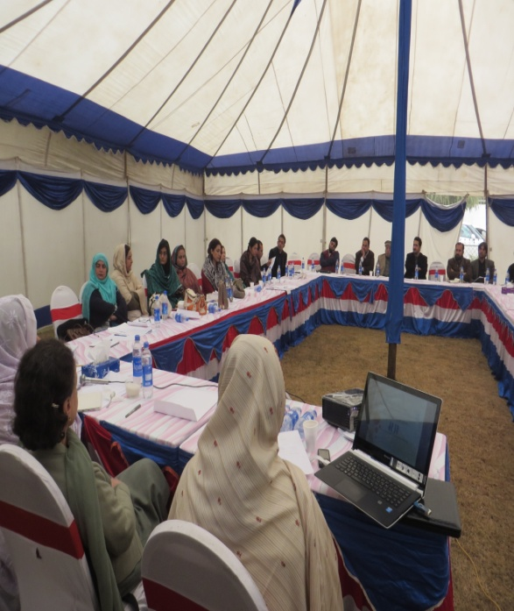
Humanitarian Response
OBJECTIVE
Communities, especially women and children, in humanitarian crises provided relief in KP and FATA
COMPONENTS:
Distribution of Food and Non Food Items
Protection (including Education, Health, Civil Rights and Livelihoods)
Humanitarian Advocacy and coordination
TDP woman receiving NFIs in Bannu
Policy dialogue on women TDPs issues

Slide 25
Outreach through Humanitarian Response program Total beneficiaries since 1993 – 9,996

Slide 26
Achievements
Case management, including Psycho social support and referrals for women through women facilitation desks.
Health facilitation to temporarily displaced (TDP) women through mobile health camps and doctors' visits
Education facility through establishing Child Friendly Spaces in camps and hosting communities
Livelihood opportunity/vocational skills training to TDP women
KK facilitated the formation of GNI (Gender Network for IDPs) the only coordinating network of civil society and the government to resolve issues affecting the lives of TDPs.

Slide 27
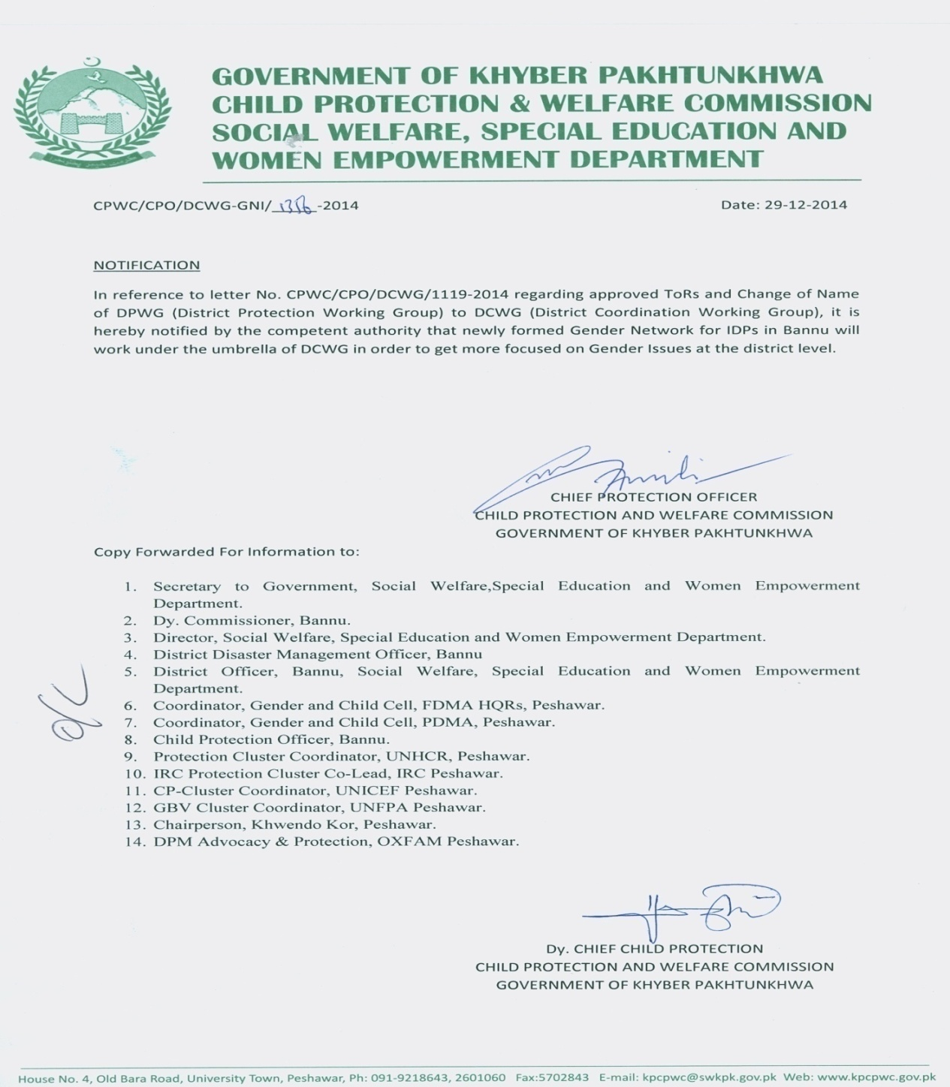
Success Story
GNI established by KK and owned by Government

Slide 28
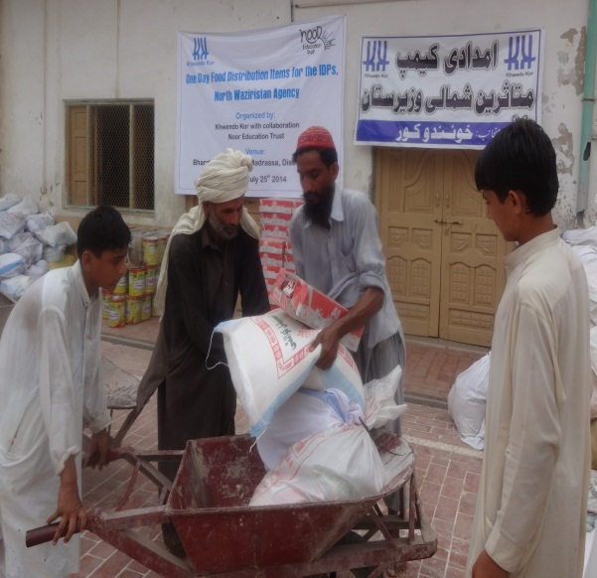
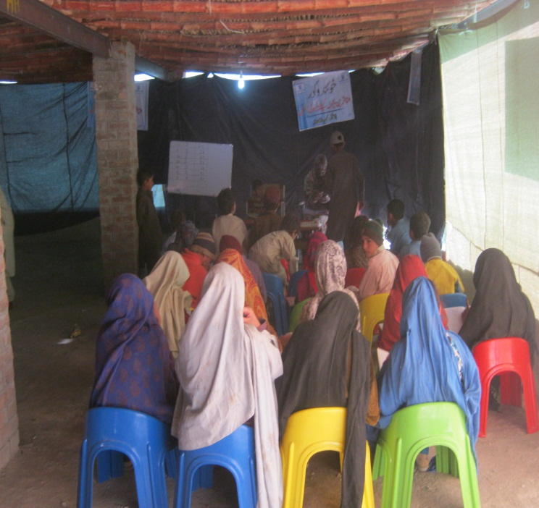
Case study :
Success story
More then 100 local Philanthropists trusted and supported KK by donating around 15 M PKR in cash and kind to facilitate Internally Displaced Persons of North Waziristan Agency in 2014 /15/16.

Slide 29
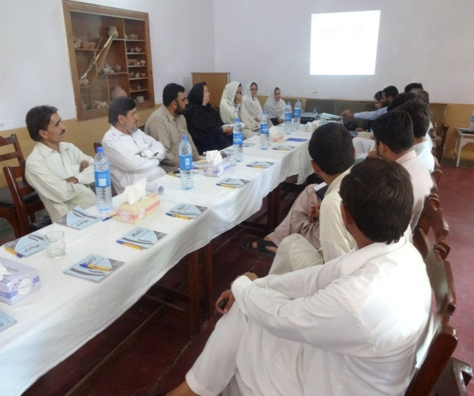
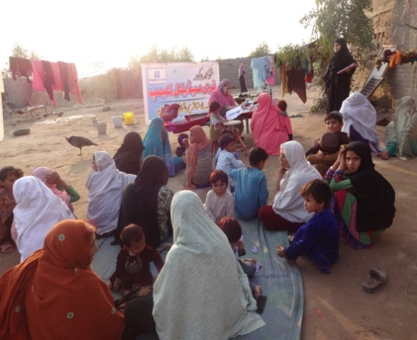
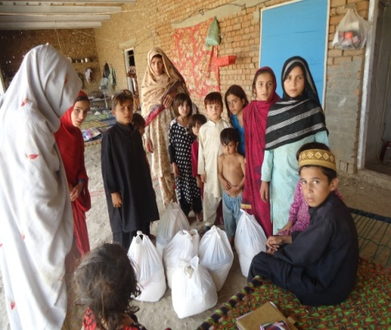
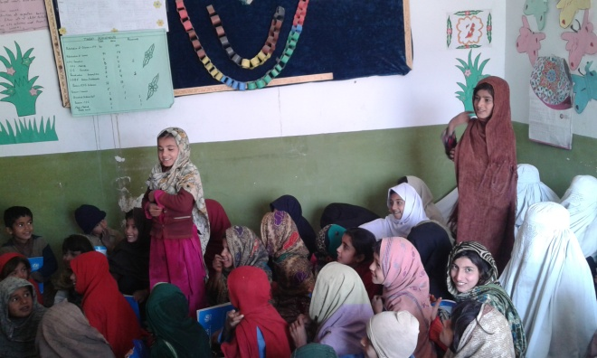

Slide 30
KK Governance System
23 GB including11 BoD
Finance and audit committee
Executive committees
At BoD Level
Executive committee
Management committee
grievance and anti harassment committee
purchase committee
regional office committees
Editorial committee
At organizational Level
Community organizations (WOs and MOs)
Thematic groups
At community Level

Slide 31
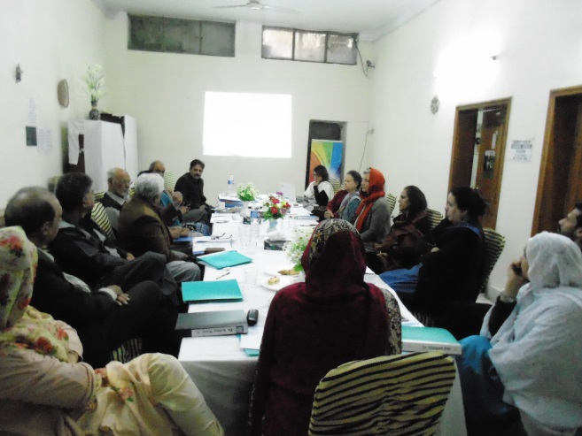
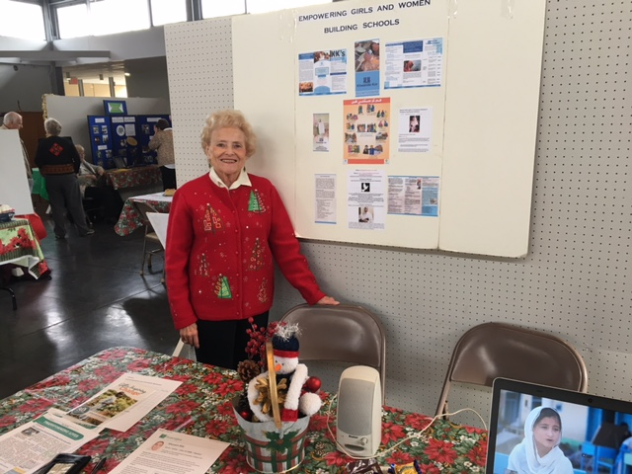
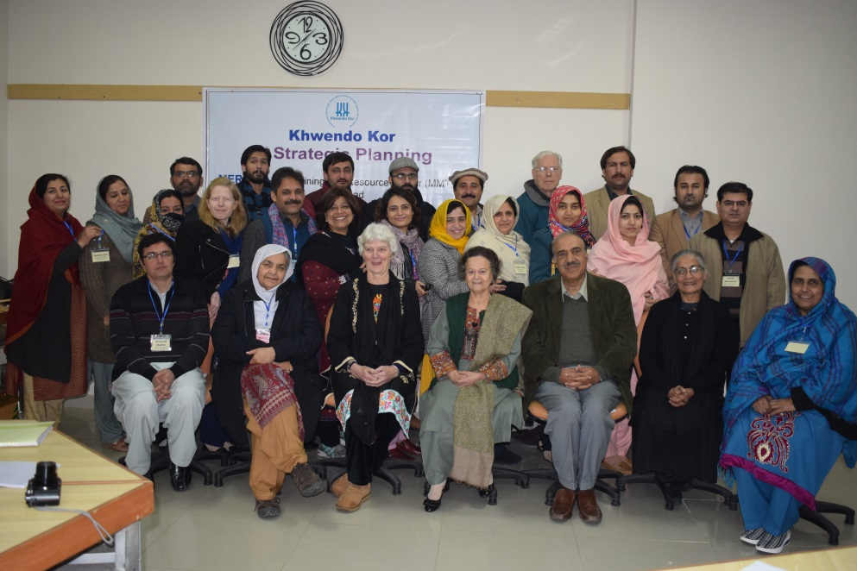
A friend of KK in USA, Marie Monson raising funds for KK education program in her individual capacity
A view of KK General Body meeting at KK Head Office Peshawar
KK team along with BoD and UKFROK members at KK Strategic Planning workshop at Islamabad
Notes:
If we are just recently registered, my guess is that we should skip this photo of Marie Monson – or at least say, “in her individual capacity…”
My preference would be a group photo from the session at Uzma’s (MWC)……..Please replace it with group picture if possible

Slide 32
KK is member of:
CHS Alliance
EVAW/G Alliance KP & FATA
The Pakistan National Committee (PNC) (IUCN)
Beijing +10Violence against Women (VAW)
Aman Ittehad (a peace movement).
HRDN (Human Resource Development Network)
TAF( The Asia Foundation)
PCP( Pakistan Centre of Philanthropy)
Paukhtunkhwa Civil Society Network (PCSN
Pakistan Coalition for Education (PCE)
The Asian South Pacific Bureau of Adult Education (ASPBAE)
Centre for Governance and Public Accountability
Child Rights Moment (CRM)
Pakistan Coalition of CSOs for Health and Immunization (PCCHI)
Rehnuma- Family Planning Association of Pakistan (FPAP)
National Aids Control Programme (NACP)
Women Chamber of Commerce KP
Saba Pakistan
Women Business Development Center (WBDC)
Islamic Micro Finance Working Group (IMWG)
International Network for Alternative Financial Institutions (INAFI)
TQK( Takrah Qabilee Khwendy)
NHN (National Humanitarian Network)

Slide 33
Recognitions
KK ‘s Chief Executive Maryam Bibi appointed as member of National Commission on the Status of Women (NCSW)
KK ranked one of the 300 top NGO worldwide by NGO advisor in 2016.
KK ‘s Chief Executive, was awarded a recognition certificate and medal under the category of "Social Activism" at "Hunar-E-Hawwa“ festival organized by Tourism Corporation, Government of KP in April 2016.
‘I am the change’ award by Engro foundation - 2013
One Hundred (Unseen) Powerful Women' by One World Action (UK) -2011
Human Rights award from President of Pakistan – 2011
IUCN Outstanding Woman - 2007-2011
National Fatima Jinnah Presidential Medal - 2010
Synergies Fellowship - 2009
International Union for Conservation of Nature - 2007 Award
Nominated for Nobel Peace Prize 2005 among one of the ‘1000 women’
Received Fatima Jinnah Award - 2003
The Human Rights Award from International Labor Organization (ILO) - 2001
The PNC Sitara-e-Imtiaz 2001, a National Presidential Award
UN Recognition Awards 2000 for its services in developing and promoting women’s and children’s rights.

Slide 34
KK international chapters/affiliates
UK Friends of Khwendo Kor UKFROK
UKFROK is registered in UK with the Charity Commission (Registration No: 1095857) http://www.frok.org.uk/
Friends of Khwendo Kor US (FOKUS)

Slide 35
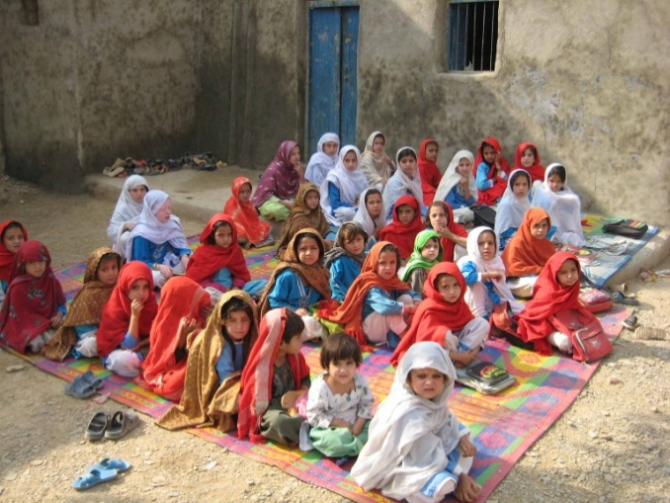
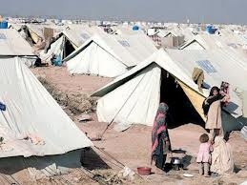
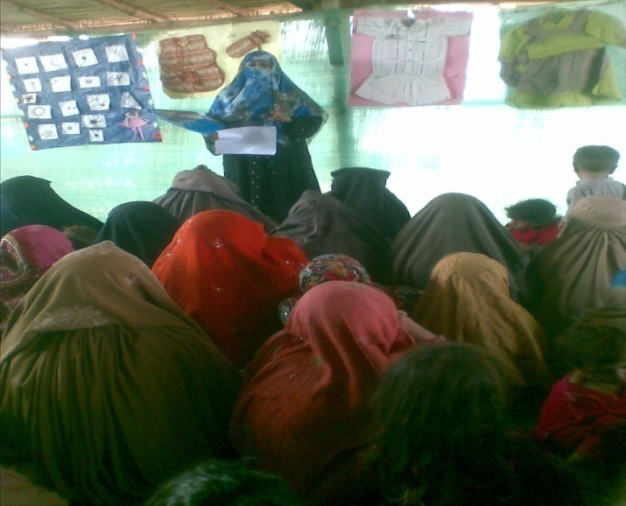
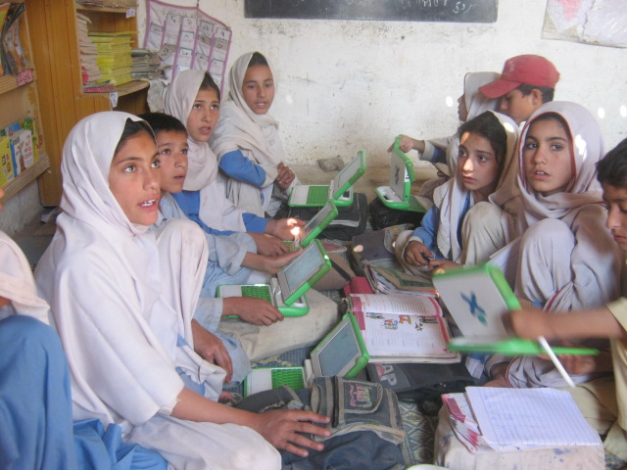
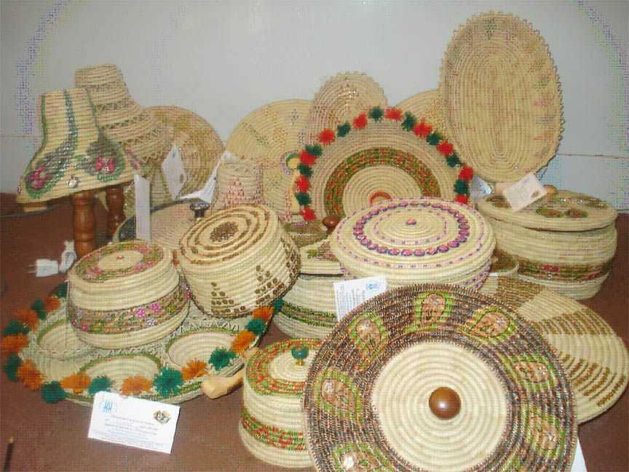
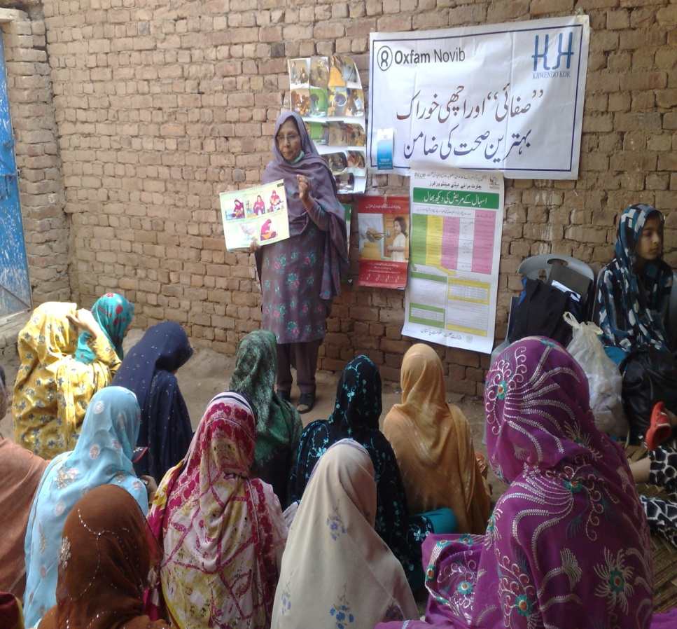
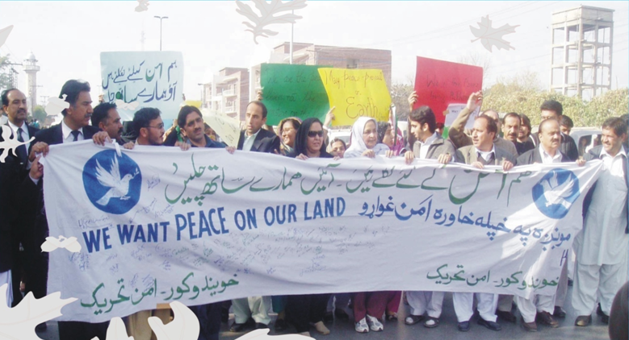
Thank you

